Slide 1
OSI Model

Slide 2
OSI
OSI stands for Open Systems Interconnection.
It has been developed by ISO – ‘International Organization for Standardization‘.
It is a 7 layer architecture with each layer having specific functionality to perform.
Outlines WHAT needs to be done to send data from one computer to another.
Not HOW it should be done.
Protocols stacks handle how data is prepared for transmittal (to be transmitted)

Slide 3
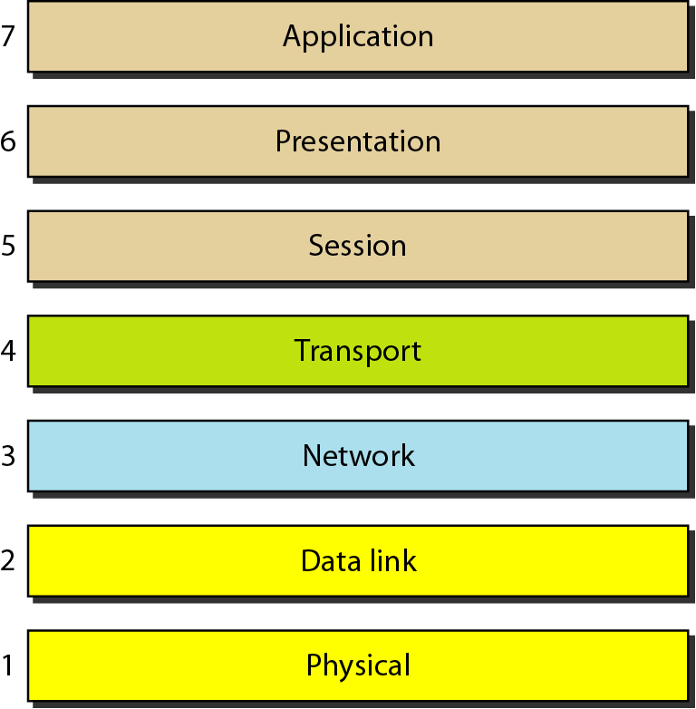
Seven Layers of the OSI model

Slide 4
Why a layered model?
Easier to teach communication process.
Speeds development, changes in one layer does not affect how the other levels works.
Standardization across manufactures.
Allows different hardware and software to work together.
Reduces complexity

Slide 5
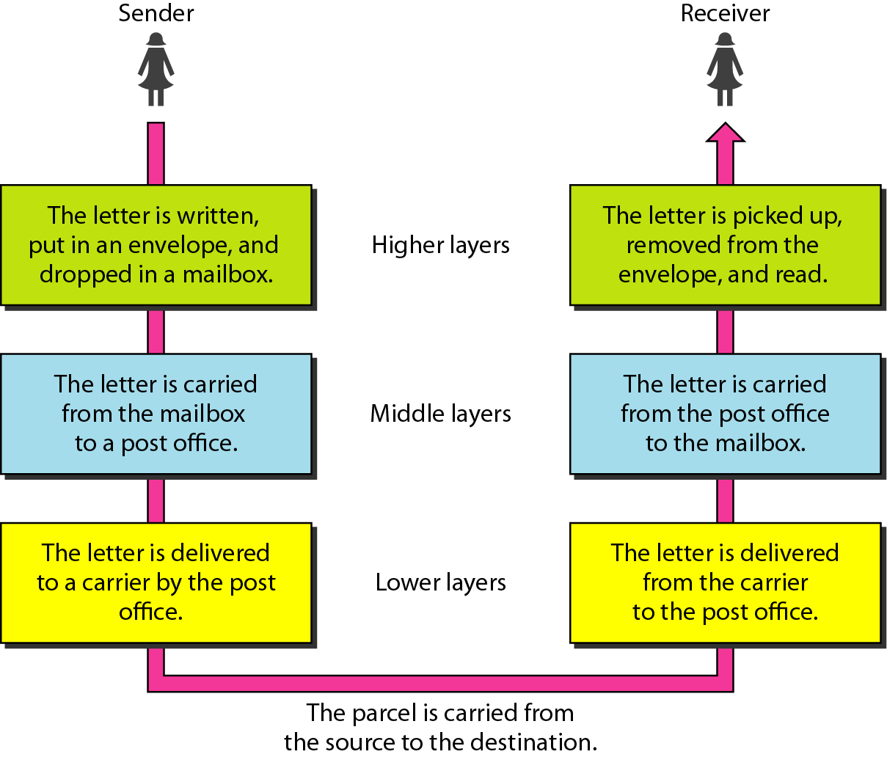
LAYERED TASKS
Tasks involved in sending a letter

Slide 6
What is “THE MODEL?”
Commonly referred to as the OSI reference model.
The OSI model
is a theoretical blueprint that helps us understand how data gets from one user’s computer to another.
It is also a model that helps develop standards so that all of our hardware and software talks nicely to each other.

Slide 7
Why use a reference model?
Serves as an outline of rules for how protocols can be used to allow communication between computers.
Each layer has its own function and provides support to other layers.

Slide 8
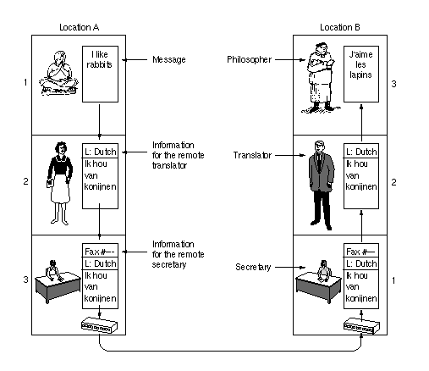
PHILOSOPHER TRANSLATOR SECRETARY
ARCHITECTURE

Slide 9
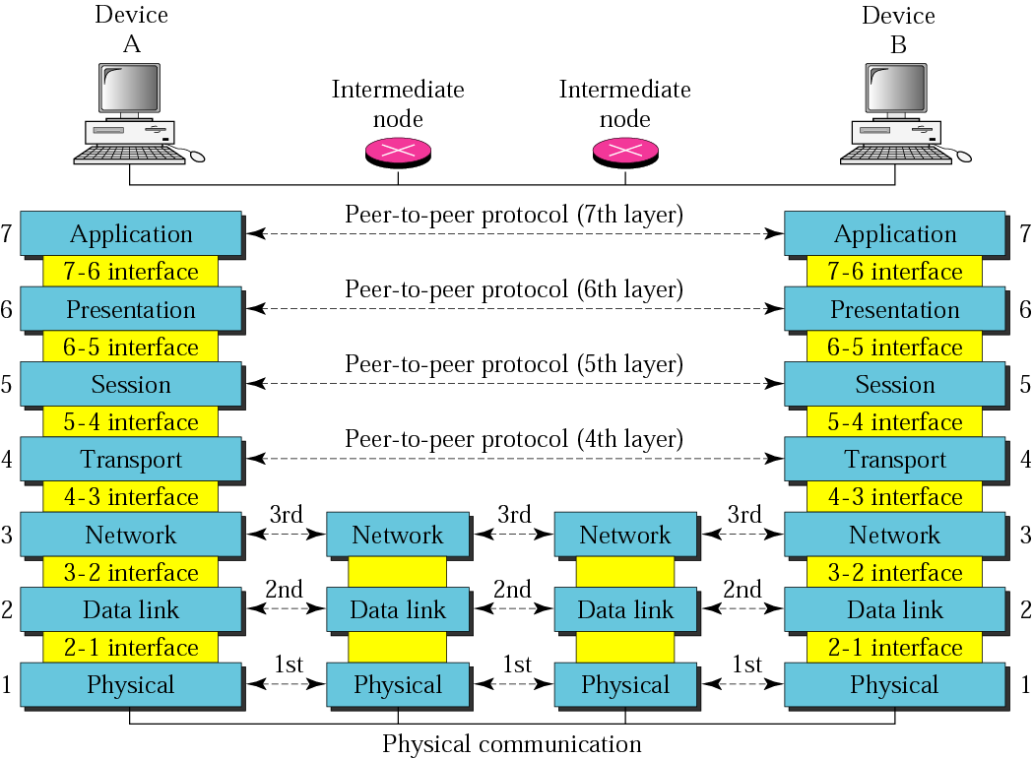
OSI Model

Slide 10
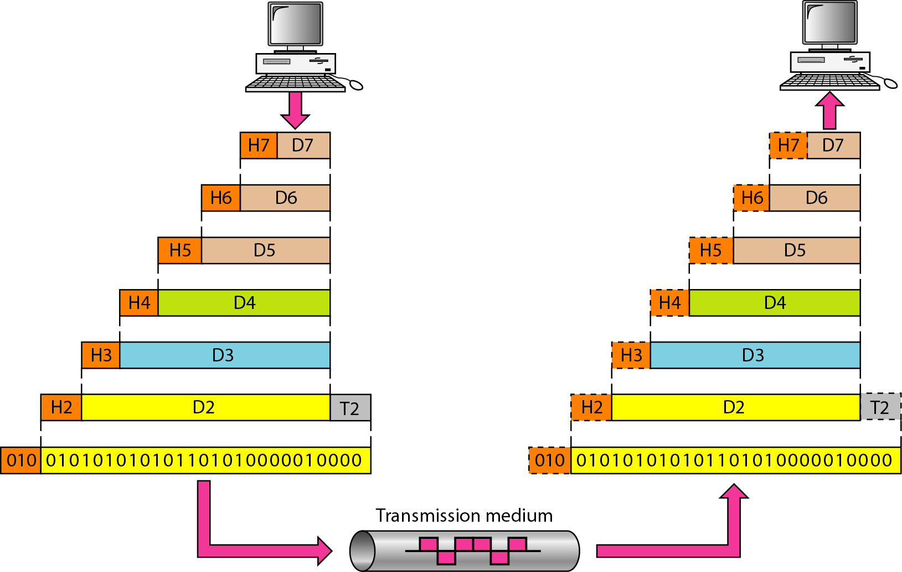
An exchange using the OSI model

Slide 11
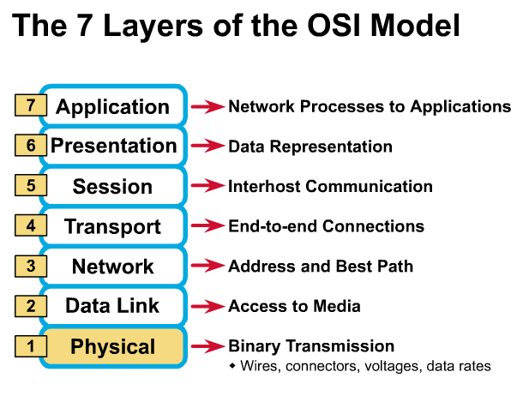
Physical Layer
Determines the specs for all physical components
Cabling
Physical topology
Representation of bits
Electrical properties
Transmission mode

Slide 12
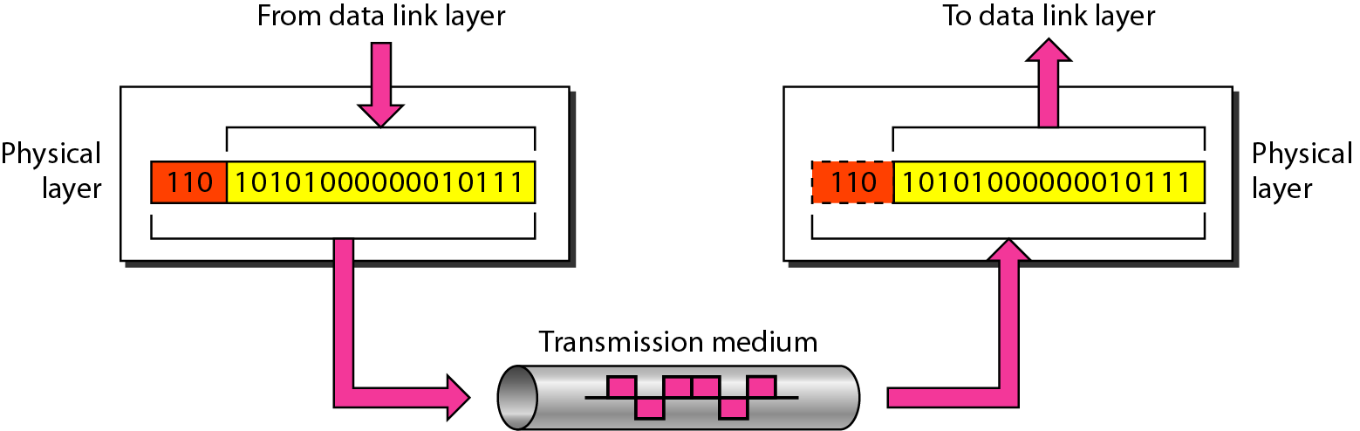
Physical layer

Slide 13

Note
The physical layer is responsible for movements of
individual bits from one hop (node) to the next.

Slide 14
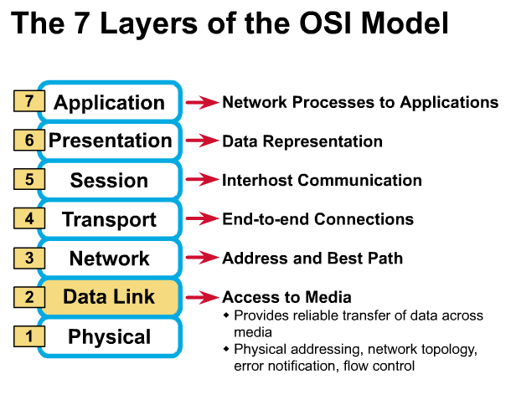
Data Link Layer
Physical Addressing
Flow control
Error control
Access control

Slide 15
FLOW CONTROL
It is a set of procedures that tells the sender how much data it can transmit before the data overwhelms the receiver.
The receiving device has limited speed and limited memory to store the data. Therefore, the receiving device must be able to inform the sending device to stop the transmission temporarily before the limits are reached.
ERROR CONTROL
The error control function of the data link layer detects the errors in transmitted frames and re-transmits all the erroneous frames.
ACCESS CONTROL
When two or more devices are connected to the same link, DLL protocols are necessary to determine which device has control over the link at any given time.

Slide 16
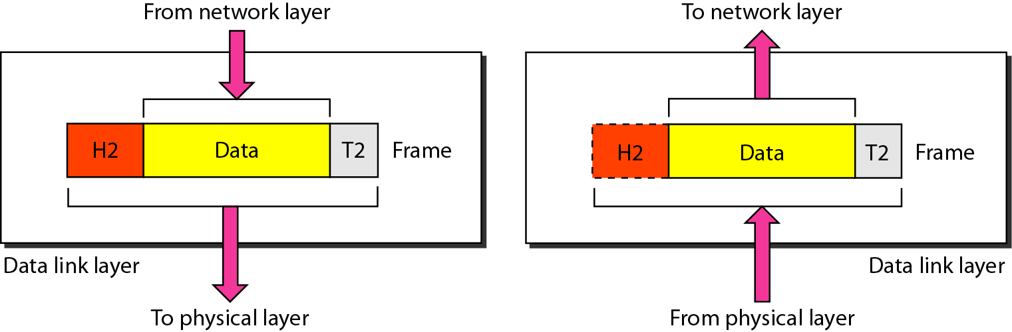
Data link layer

Slide 17
Note
The data link layer is responsible for moving frames from one hop (node) to the next.

Slide 18
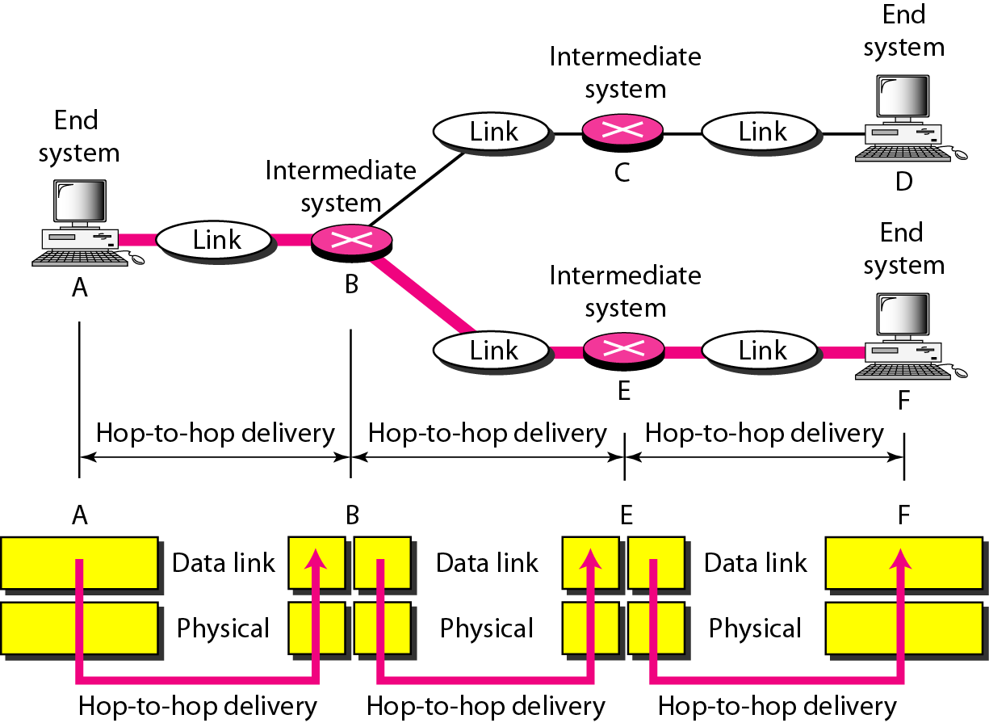
Hop-to-hop delivery

Slide 19
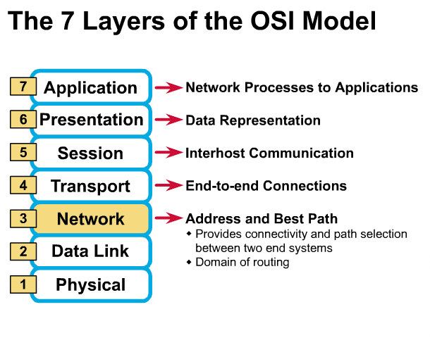
Network Layer
Logical Addressing
Routing

Slide 20
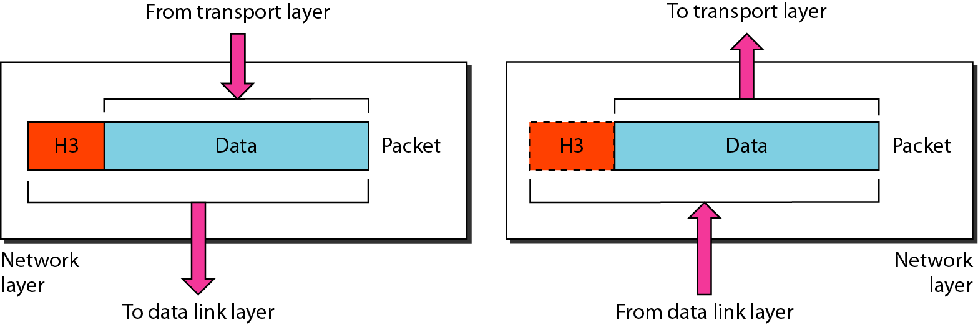
Network layer

Slide 21
Note
The network layer is responsible for the delivery of individual packets from
the source host to the destination host.

Slide 22
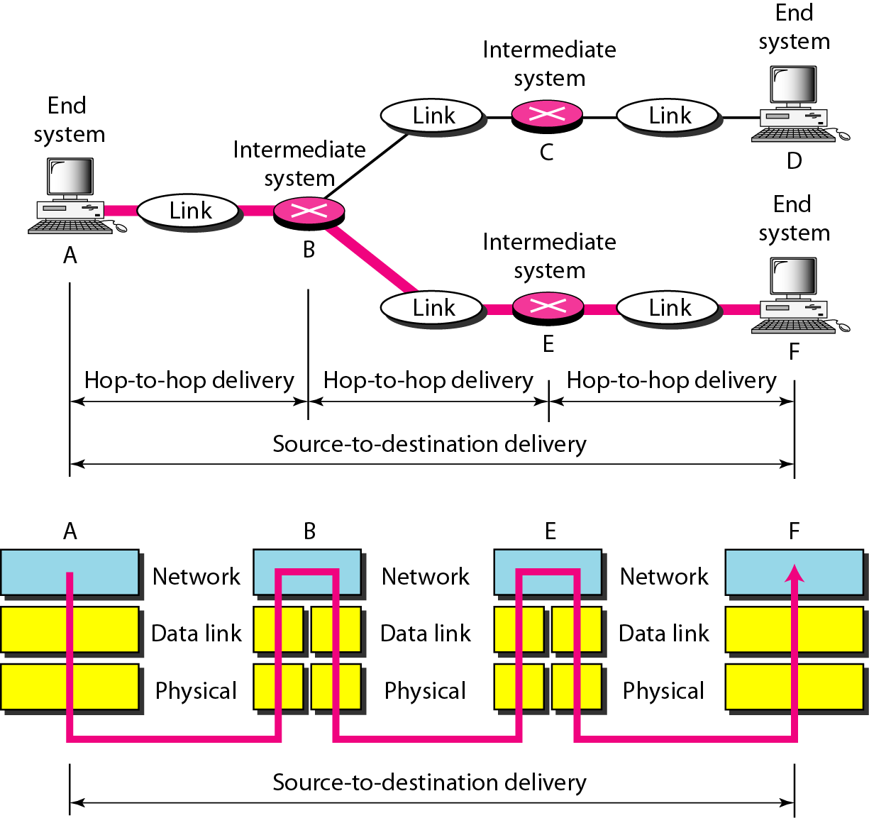
Source-to-destination delivery

Slide 23
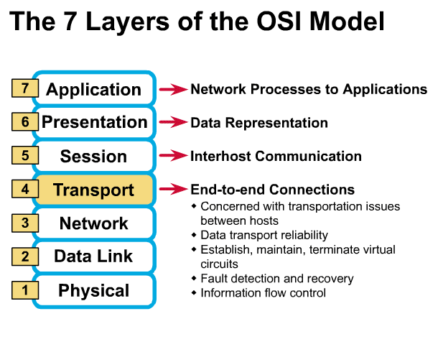
Transport Layer
Service Point Addressing
Segment and reassembly
Flow Control
Error Control
Connection Control
³

Slide 24
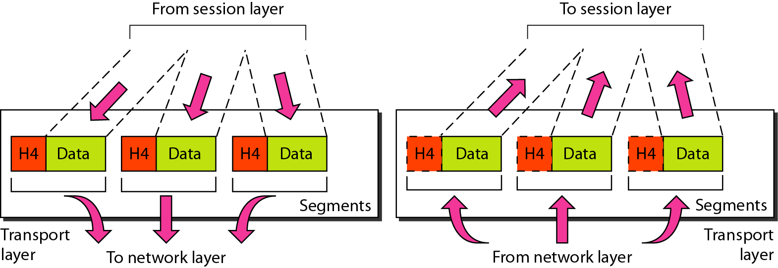
Transport layer

Slide 25
Note
The transport layer is responsible for the delivery of a message from one process to another.

Slide 26
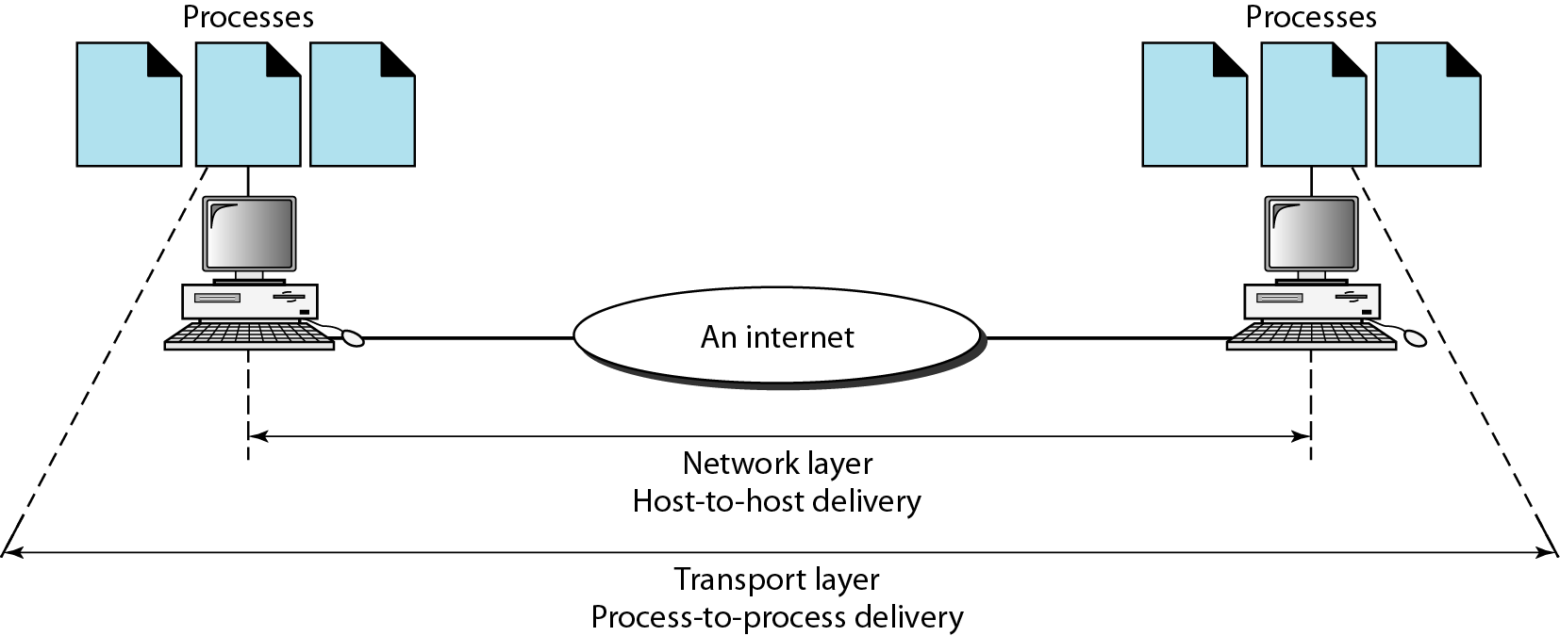
Reliable process-to-process delivery of a message

